Slide 1
Topic 5 First Law of Thermodynamics
Thermodynamics: An Engineering Approach
8th Edition Yunus A. Çengel, Michael A. Boles
McGraw-Hill, 2015

Slide 2
Objectives
Explain the basic concepts of thermodynamics such as system, process, and cycle.
Define the concept of heat and the terminology associated with energy transfer by heat.
Discuss the three mechanisms of heat transfer: conduction, convection, and radiation.
Define the concept of work, including electrical work and several forms of mechanical work.
Introduce the first law of thermodynamics, energy balances, and mechanisms of energy transfer to or from a system.
Determine that a fluid flowing across a control surface of a control volume carries energy across the control surface in addition to any energy transfer across the control surface that may be in the form of heat and/or work.

Slide 3
SYSTEMS AND CONTROL VOLUMES
System: A quantity of matter or a region in space chosen for study.
Surroundings: The mass or region outside the system
Boundary: The real or imaginary surface that separates the system from its surroundings.
The boundary of a system can be fixed or movable.
Systems may be considered to be closed or open.
Closed system (Control mass): A fixed amount of mass, and no mass can cross its boundary

Slide 4
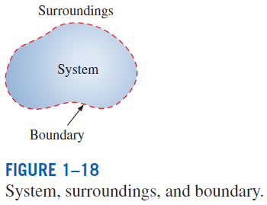
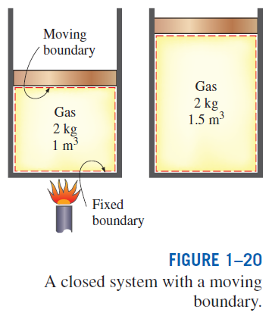
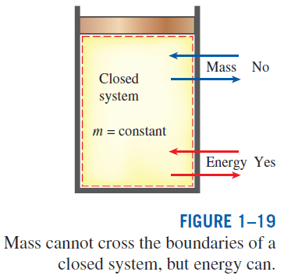

Slide 5
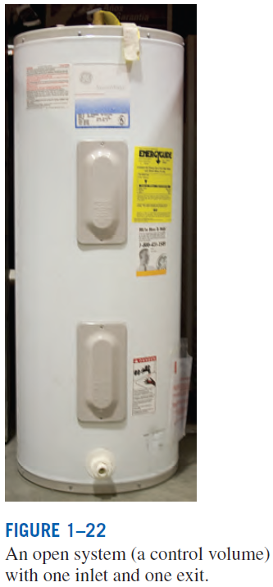
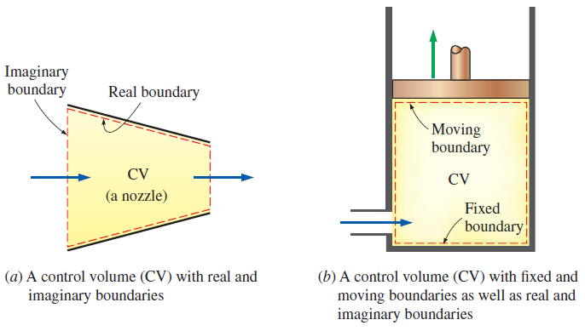
Open system (control volume): A properly selected region in space.
It usually encloses a device that involves mass flow such as a compressor, turbine, or nozzle.
Both mass and energy can cross the boundary of a control volume.
Control surface: The boundaries of a control volume. It can be real or imaginary.
A control volume can involve fixed, moving, real, and imaginary boundaries.

Slide 6
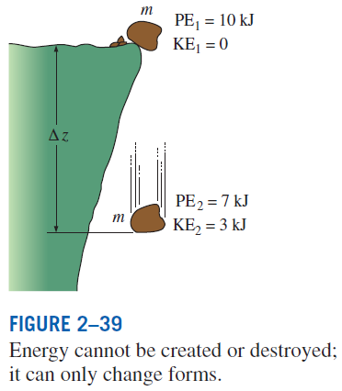
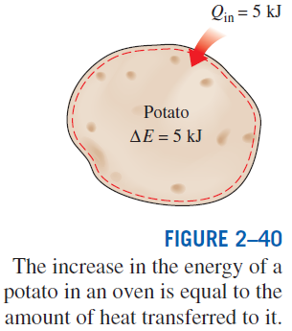
THE FIRST LAW OF THERMODYNAMICS
The first law of thermodynamics (the conservation of energy principle) provides a sound basis for studying the relationships among the various forms of energy and energy interactions.
The first law states that energy can be neither created nor destroyed during a process; it can only change forms.
The First Law: For all adiabatic processes between two specified states of a closed system, the net work done is the same regardless of the nature of the closed system and the details of the process.

Slide 7
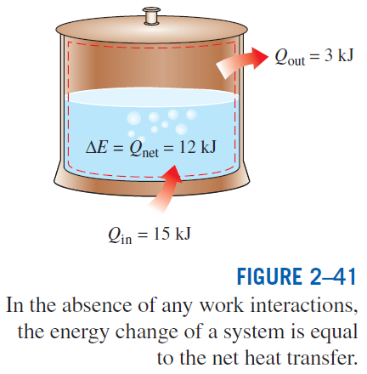
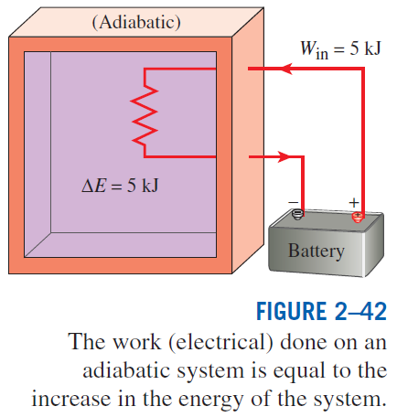

Slide 8
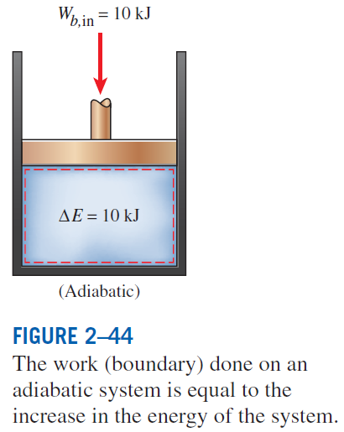
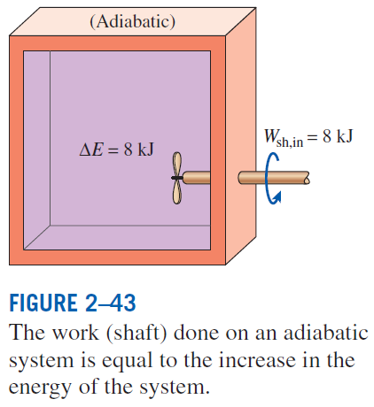

Slide 9

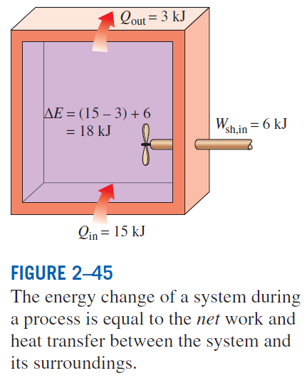
Energy Balance
The net change (increase or decrease) in the total energy of the system during a process is equal to the difference between the total energy entering and the total energy leaving the system during that process.

Slide 10
Example A heater running off 120 V and 5 A with an efficiency of 70% is used to heat a pool. The pool loses heat at a constant rate of 120 W. Over the course of the day, the sun provides 500 kJ of heat over a 6 hour period. Determine the rate of heating (or cooling) in the pool. What is the net energy gain (or lost) by the pool after the 6 hour sunny period?
Example 1

Slide 11
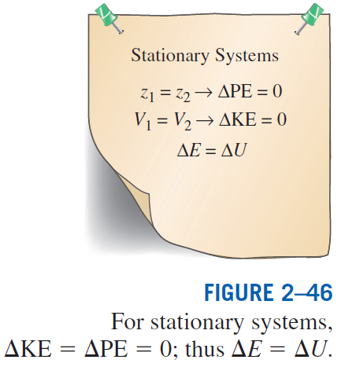
Energy Change of a System, ΔE_{system}
Internal, kinetic, and potential energy changes

Slide 12
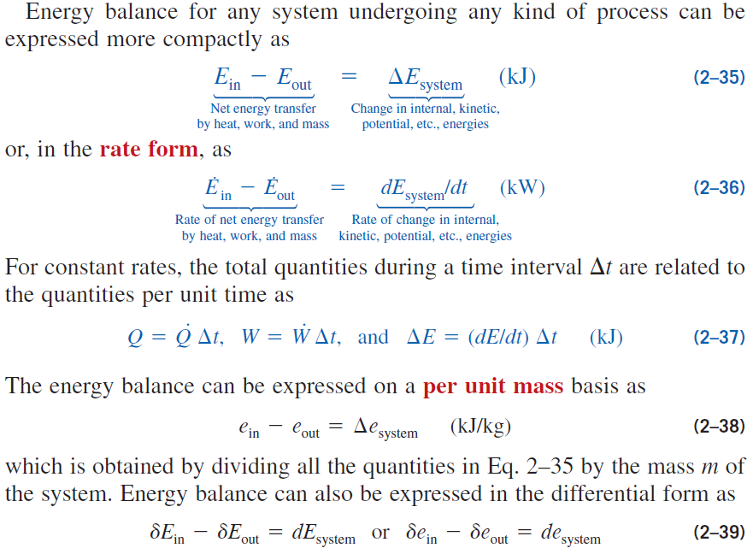
Mechanisms of Energy Transfer, E_{in} and E_{out}

Slide 13
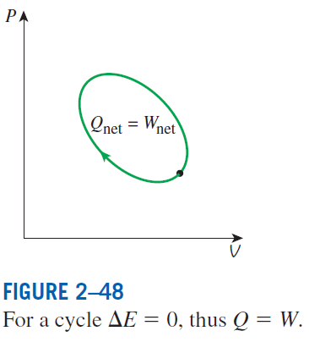
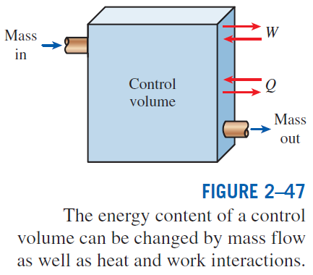
Mechanisms of energy transfer:
Heat transfer
Work transfer
Mass flow
A closed mass involves only heat transfer and work.

Slide 14
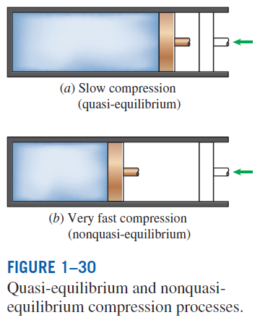
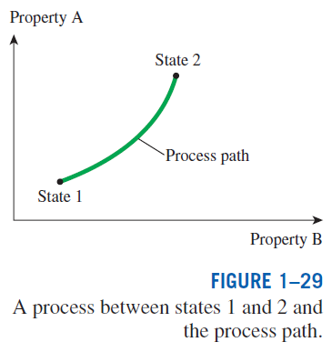
PROCESSES AND CYCLES
Process: Any change that a system undergoes from one equilibrium state to another.
Path: The series of states through which a system passes during a process.
To describe a process completely, one should specify the initial and final states, as well as the path it follows, and the interactions with the surroundings.
Quasistatic or quasi-equilibrium process: When a process proceeds in such a manner that the system remains infinitesimally close to an equilibrium state at all times.

Slide 15
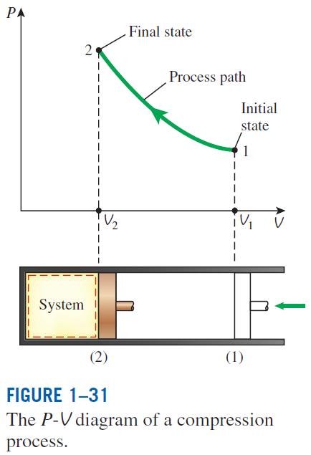
Process diagrams plotted by employing thermodynamic properties as coordinates are very useful in visualizing the processes.
Some common properties that are used as coordinates are temperature T, pressure P, and volume V (or specific volume v).
The prefix iso- is often used to designate a process for which a particularproperty remains constant.
Isothermal process: A process during which the temperature T remains constant.
Isobaric process: A process during which the pressure P remains constant.
Isochoric (or isometric) process: A process during which the specific volume v remains constant.
Cycle: A process during which the initial and final states are identical.

Slide 16
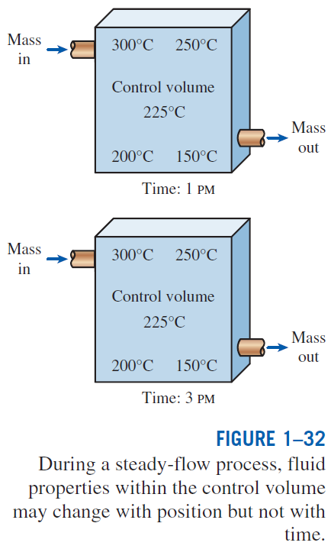
The Steady-Flow Process
The term steady implies no change with time. The opposite of steady is unsteady, or transient.
A large number of engineering devices operate for long periods of time under the same conditions, and they are classified as steady-flow devices.
Steady-flow process: A process during which a fluid flows through a control volume steadily.
Steady-flow conditions can be closely approximated by devices that are intended for continuous operation such as turbines, pumps, boilers, condensers, and heat exchangers or power plants or refrigeration systems.

Slide 17
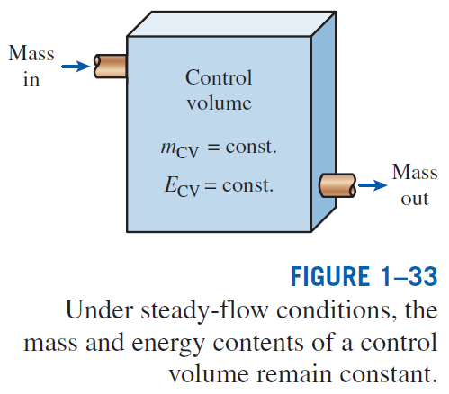

Slide 18
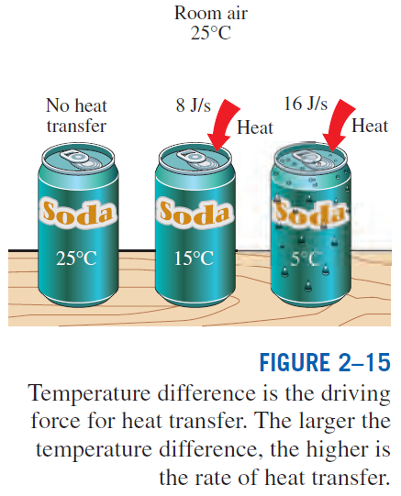
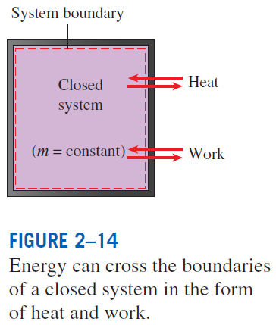
ENERGY TRANSFER BY HEAT
Heat: The form of energy that is transferred between two systems (or a system and its surroundings) by virtue of a temperature difference.

Slide 19
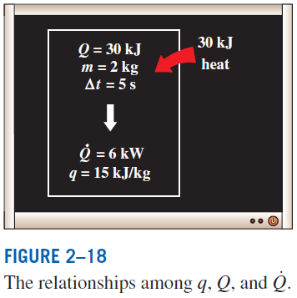
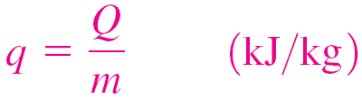
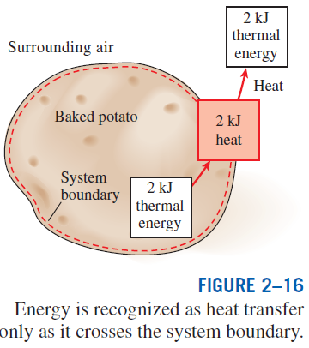
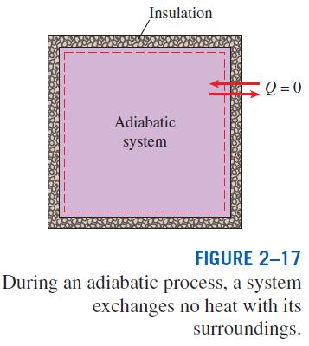
Heat transfer per unit mass
Amount of heat transfer when heat transfer rate is constant
Amount of heat transfer when heat transfer rate changes with time

Slide 20
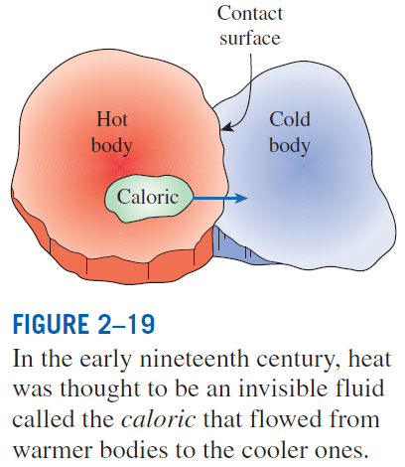
Historical Background on Heat
Kinetic theory: Treats molecules as tiny balls that are in motion and thus possess kinetic energy.
Heat: The energy associated with the random motion of atoms and molecules.
Heat transfer mechanisms:
Conduction: The transfer of energy from the more energetic particles of a substance to the adjacent less energetic ones as a result of interaction between particles.
Convection: The transfer of energy between a solid surface and the adjacent fluid that is in motion, and it involves the combined effects of conduction and fluid motion.
Radiation: The transfer of energy due to the emission of electromagnetic waves (or photons).

Slide 21
Mechanisms of Heat Transfer
There are 3 modes of heat transfer:
Conduction
Convection
Radiation
All modes require temperature difference between source and sink
Heat transfers from high temperature to low temperature

Slide 22
Conduction
Transfer of more energetic particles to less energetic particles
Occurs in solids, liquids, and gasses
Liquids and gasses: collision of molecules during random motion (Brownian motion)
Solids: combination of crystal lattice vibrations and energy transport by free electrons

Slide 23
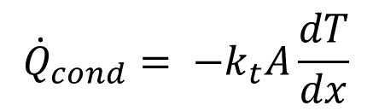
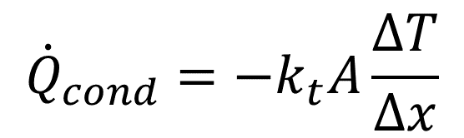
Conduction
$${\dot{Q}}_{cond}=−k_{t}A\frac{ΔT}{Δx}$$
Heat of conduction is proportional to temperature difference (ΔT) and area normal to heat transfer
Thermal conductivity, k_{t}: proportionality constant measures material’s ability to conduct heat
Conductors (e.g. most metals) have high k_{t}
Insulators (e.g. wood, styrofoam) have low k_{t}
Fourier’s law of heat conduction
Negative sign is used due to negative temperature gradient
$${\dot{Q}}_{cond}= {−k}_{t}A\frac{dT}{dx}$$

Slide 24
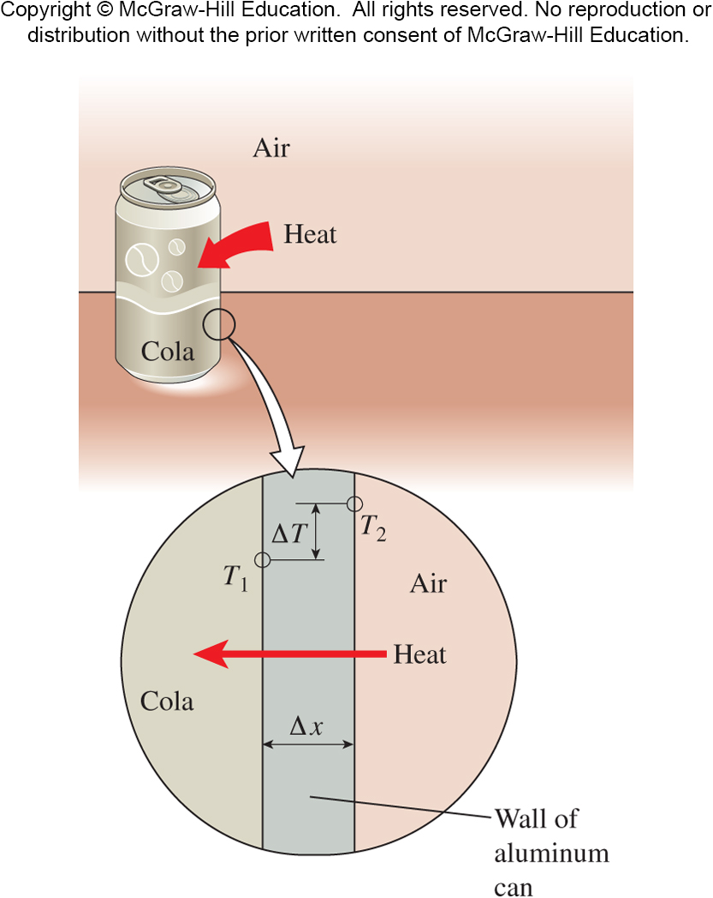
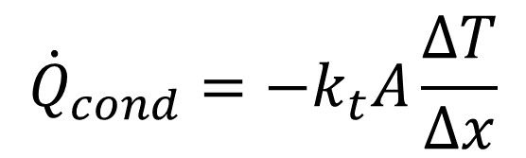
Conduction
$${\dot{Q}}_{cond}=−k_{t}A\frac{ΔT}{Δx}$$

Slide 25
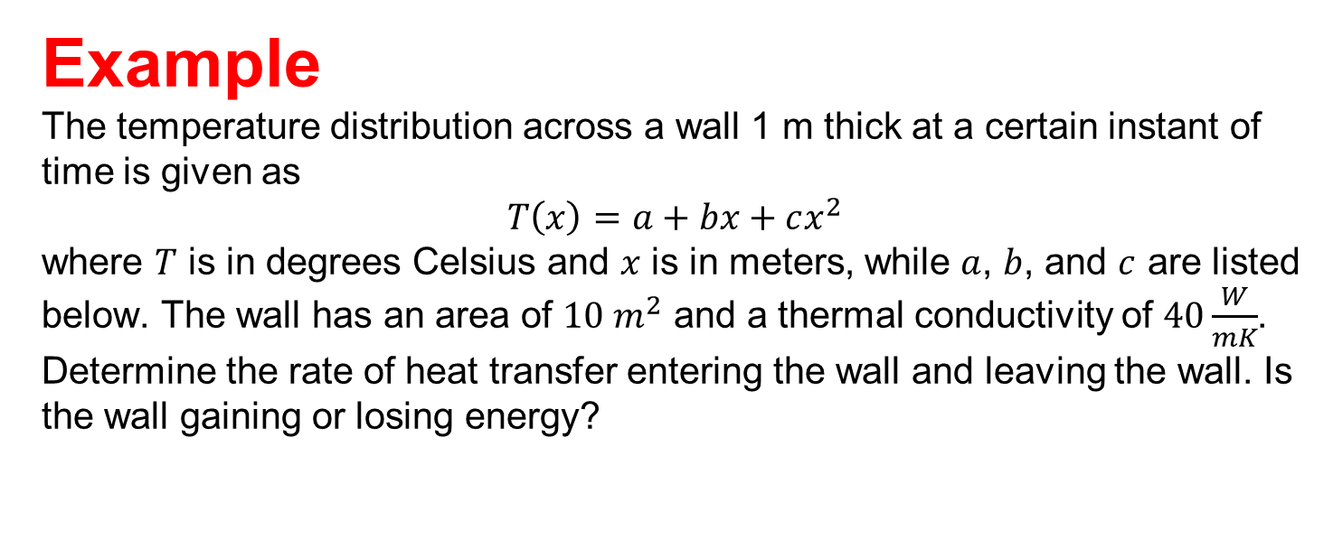



Example The temperature distribution across a wall 1 m thick at a certain instant of time is given as $$T\left(x\right)=a+bx+cx^{2}$$ where $T$ is in degrees Celsius and $x$ is in meters, while $a$, $b$, and $c$ are listed below. The wall has an area of $10 m^{2}$ and a thermal conductivity of $40\frac{W}{mK}$. Determine the rate of heat transfer entering the wall and leaving the wall. Is the wall gaining or losing energy?
$$a=900℃$$
$$b=−300\frac{℃}{m}$$
$$c=−50\frac{℃}{m^{2}}$$
Example 2

Slide 26
Convection
Transfer of energy to/from a solid surface from/to an adjacent moving fluid (liquid or gas)
Combination of conduction and fluid motion
Faster fluid motion results in more heat transfer
If fluid is motionless then pure conduction occurs
Forced convection: fluid is forced over surface by external means (fan, pump, wind, etc.)
Free (or natural) convection: fluid motion is caused by buoyancy force due to changes in density (e.g. warmer air rises because it is less dense)

Slide 27

Convection
Heat transfer in processes that involve phase changes in fluids are consider to be convection
Movement of vapor bubbles through a liquid (evaporation)
Falling of liquid droplets (condensation)
Newton’s Law of Cooling
Convective heat transfer coefficient, h
not a property of the fluid
Determined experimentally; affected by surface geometry, fluid properties, fluid velocity
T_{s} – surface temperature; T_{f} – bulk fluid temperature
Note: the temperature of fluid at the surface is T_{s} not T_{f} (continuum)
$${\dot{Q}}_{conv}=hA\left(T_{s}−T_{f}\right)$$

Slide 28
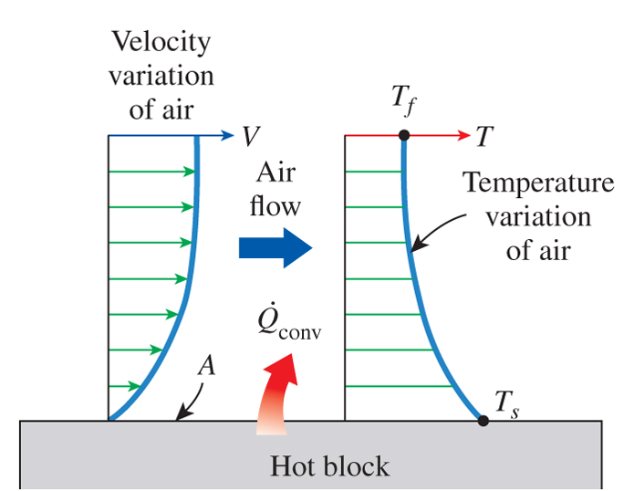

Convection
$${\dot{Q}}_{conv}=hA\left(T_{s}−T_{f}\right)$$

Slide 29
Radiation
Energy is emitted by matter in the form of electromagnetic waves (or photons)
Results from the change of electronic configurations of atoms or molecules
Does not require presence of medium between source and sink; can work in a vacuum
All bodies at a temperature above absolute zero emit thermal radiation

Slide 30



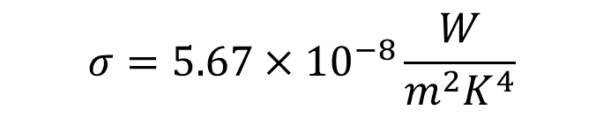
Radiation
$$σ=5.67×{10}^{−8}\frac{W}{m^{2}K^{4}}$$
Maximum radiation from a surface: Stefan-Boltzman’s Law
Surface that emits maximum radiation is called a blackbody
Real surfaces emit less than the maximum
Emissivity, ε : material property between 0 and 1 (for blackbodies ε = 1)
For a large surface surrounding a radiation source:
$${\dot{Q}}_{emit,max}= σAT_{s}^{4}$$
$${\dot{Q}}_{emit,max}= εσAT_{s}^{4}$$
$${\dot{Q}}_{rad}= εσA\left(T_{s}^{4}−T_{surr}^{4}\right)$$

Slide 31
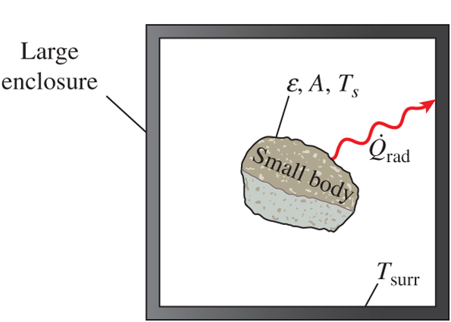

Radiation
$${\dot{Q}}_{rad}= εσA\left(T_{s}^{4}−T_{surr}^{4}\right)$$

Slide 32
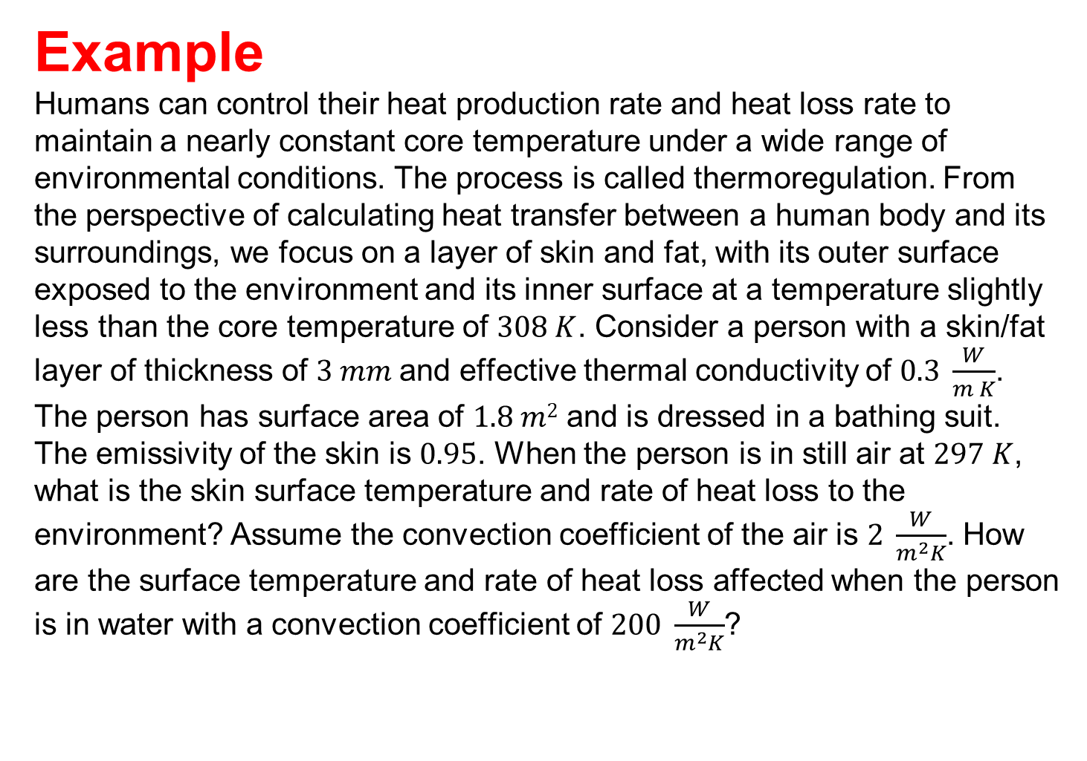
Example Humans can control their heat production rate and heat loss rate to maintain a nearly constant core temperature under a wide range of environmental conditions. The process is called thermoregulation. From the perspective of calculating heat transfer between a human body and its surroundings, we focus on a layer of skin and fat, with its outer surface exposed to the environment and its inner surface at a temperature slightly less than the core temperature of $308 K$. Consider a person with a skin/fat layer of thickness of $3 mm$and effective thermal conductivity of $0.3 \frac{W}{m K}$. The person has surface area of $1.8 m2$ and is dressed in a bathing suit. The emissivity of the skin is $0.95$. When the person is in still air at $297 K$, what is the skin surface temperature and rate of heat loss to the environment? Assume the convection coefficient of the air is $2 \frac{W}{m^{2}K}$. How are the surface temperature and rate of heat loss affected when the person is in water with a convection coefficient of $200 \frac{W}{m^{2}K}$?
Example 3

Slide 33
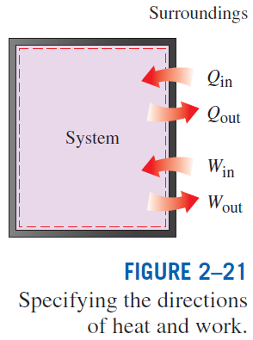
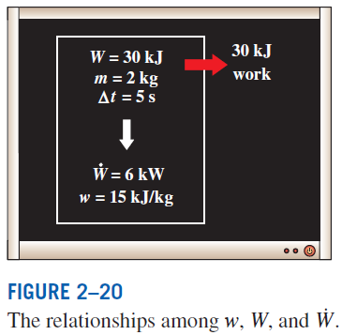
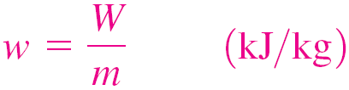
ENERGY TRANSFER BY WORK
Work: The energy transfer associated with a force acting through a distance.
A rising piston, a rotating shaft, and an electric wire crossing the system boundaries are all associated with work interactions
Formal sign convention: Heat transfer to a system and work done by a system are positive; heat transfer from a system and work done on a system are negative.
Alternative to sign convention is to use the subscripts in and out to indicate direction. This is the primary approach in this text.
Work done per unit mass

Slide 34
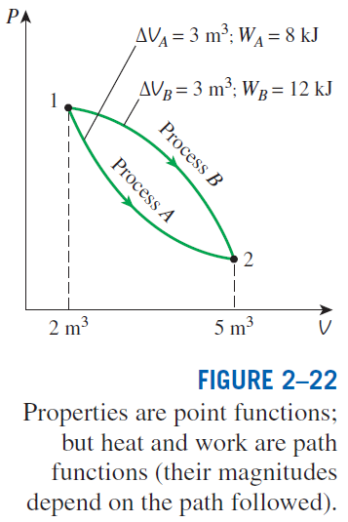
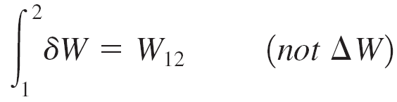
Heat vs. Work
Both are recognized at the boundaries of a system as they cross the boundaries. That is, both heat and work are boundary phenomena.
Systems possess energy, but not heat or work.
Both are associated with a process, not a state.
Unlike properties, heat or work has no meaning at a state.
Both are path functions (i.e., their magnitudes depend on the path followed during a process as well as the end states).
Properties are point functions have exact differentials (d ).
Path functions have inexact differentials (δ )

Slide 35
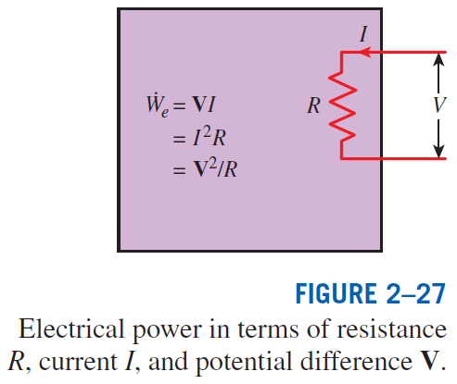

Electrical Work
Electrical work
Electrical power
When potential difference and current change with time
When potential difference and current remain constant

Slide 36
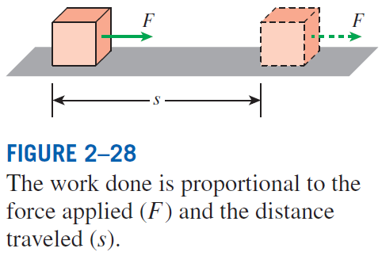

MECHANICAL FORMS OF WORK
There are two requirements for a work interaction between a system and its surroundings to exist:
there must be a force acting on the boundary.
the boundary must move.
Work = Force × Distance
When force is not constant

Slide 37
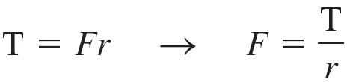
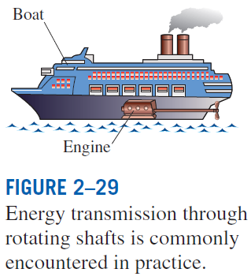
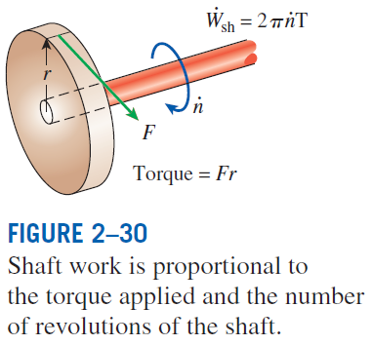
Shaft Work
A force F acting through a moment arm r generates a torque T
This force acts through a distance s
Shaft work
The power transmitted through the shaft is the shaft work done per unit time

Slide 38

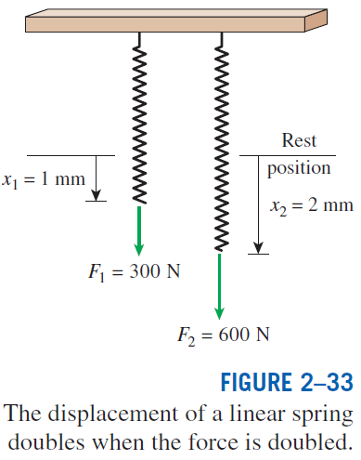
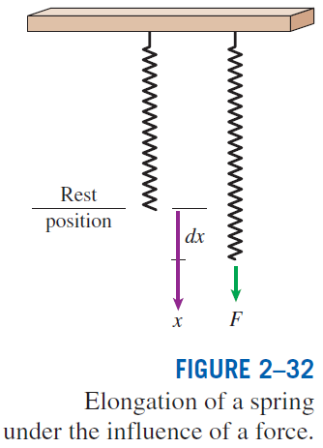
Spring Work
When the length of the spring changes by
a differential amount dx under the influence of a force F, the work done is
Substituting and integrating yield
For linear elastic springs, the displacement x is proportional to the force applied
x₁ and x₂: the initial and the final displacements
k: spring constant (kN/m)

Slide 39
Example Determine the energy necessary to stretch a spring (with a spring constant of 200 lbf/in) 4 inches. Express your answer in Btu.
Useful Information: 1 Btu = 778.169 lbf · ft
Example 4

Slide 40
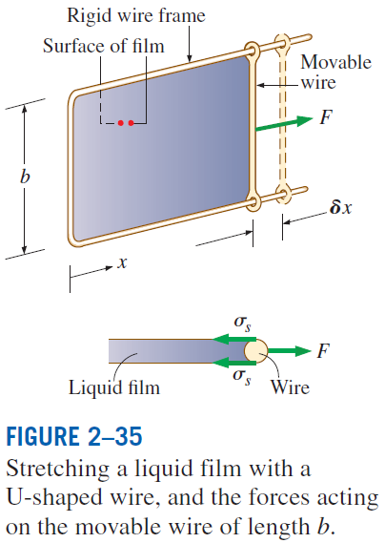

Work Done on Elastic Solid Bars
Work Associated with the Stretching of a Liquid Film

Slide 41

Work Done to Raise or to Accelerate a Body
The work transfer needed to raise a body is equal to the change in the potential energy of the body.
The work transfer needed to accelerate a body is equal to the change in the kinetic energy of the body.
Nonmechanical Forms of Work
Electrical work: The generalized force is the voltage (the electrical potential) and the generalized displacement is the electrical charge.
Magnetic work: The generalized force is the magnetic field strength and the generalized displacement is the total magnetic dipole moment.
Electrical polarization work: The generalized force is the electric field strength and the generalized displacement is the polarization of the medium.

Slide 42
Summary
Systems and control volumes
Processes and cycles
The steady-flow process
Energy transfer by heat
Energy transfer by work
Mechanical forms of work
The first law of thermodynamics
Energy balance
Energy change of a system
Mechanisms of energy transfer (heat, work, mass flow)

